Slide 1

Jupyter Notebooks
An Introduction to Programming in Python
Notes:
Let's learn about Jupyter Notebooks

Slide 2
Data Science
Computer Science
Statistics
Data Science
Subject Matter Expertise
Notes:
Data Science is a profession that combines Computer Science, Statistics, and many other disciplines to answer questions about the world.
Data Scientists use data and programming to answer real questions.
Python is a popular language for Data Science because there are many tools available to make that task easier.
Jupter Notebooks are one such tool.

Slide 3
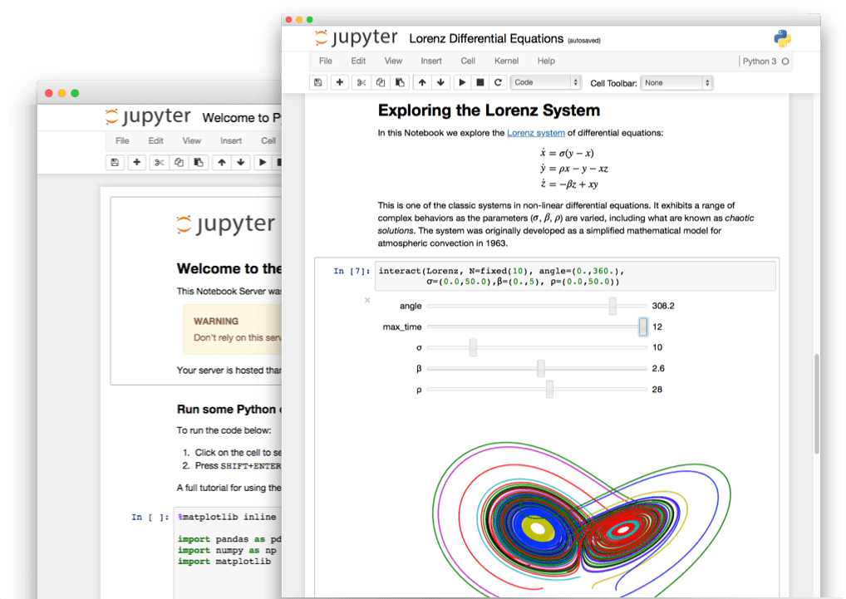
What Are Jupyter Notebooks
Notebook, Jupyter. "Home page, 5 March 2017."
Notes:
A Jupyter Notebook is a document that can combine text, code, and the output of code all into one place.
Data Scientists use Jupyter Notebooks to share the results of their analysis in such a way that colleagues can review the results and the process.

Slide 4
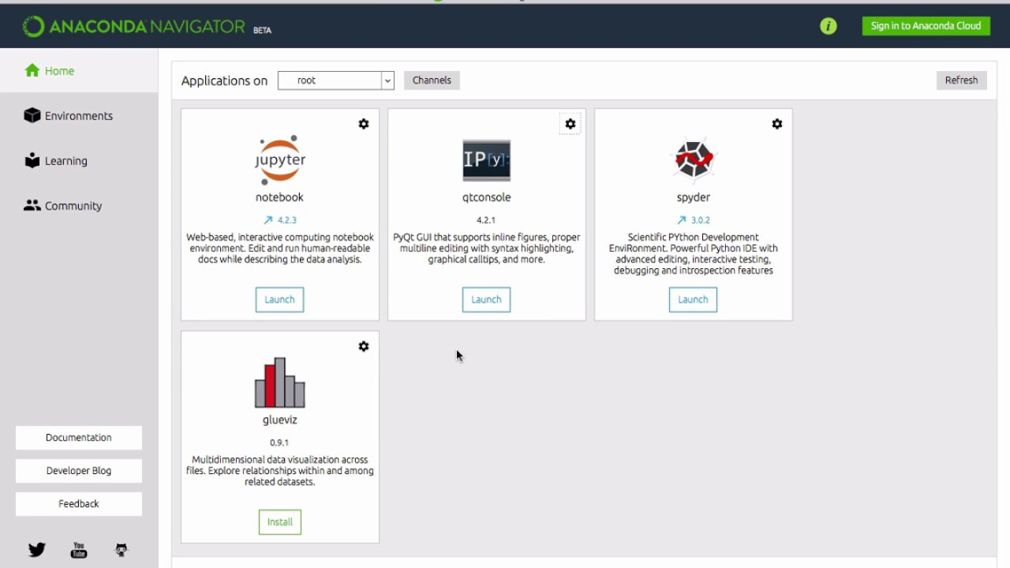
Launching
Jupyter Notebooks
Notes:
Jupyter is easily installed as part of the Anaconda distribution of Python.
Either by searching for the "Jupyter Notebook" application on your computer, or using the Anaconda Navigator, you can easily launch Jupyter.

Slide 5
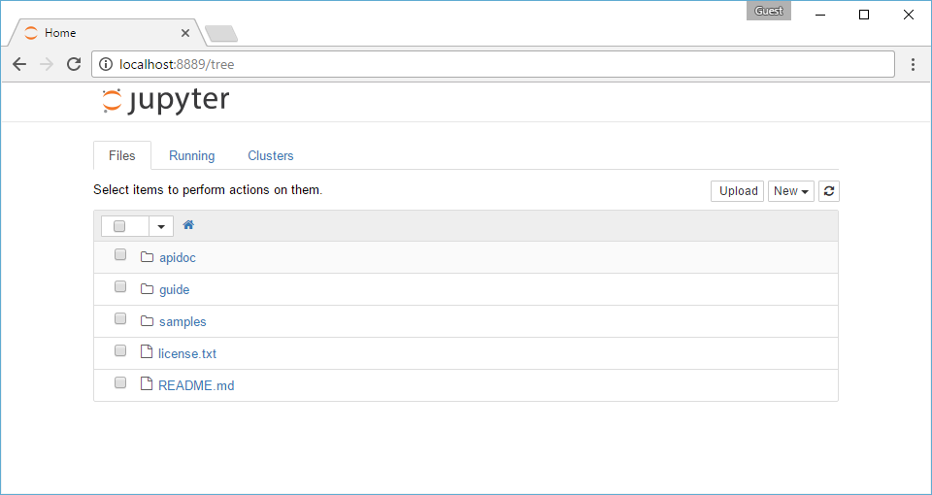
Navigating
Files and directories
Notes:
Once Jupyter finishes loading, a new browser window will appear.
This window represents a folder on your computer that will store your Jupyter Notebooks.
You can choose any existing notebooks, which you may not have yet, by clicking on any files with a "ipynb" extension.
You may see other files and folders there, but you can ignore them.

Slide 6
Creating
New
Notes:
To create a new Notebook, click the "New" button in the top right, and then choose the "Python [conda root]" option from the "Notebooks" heading.
A new window will open with your freshly created Notebook ready to be edited.

Slide 7
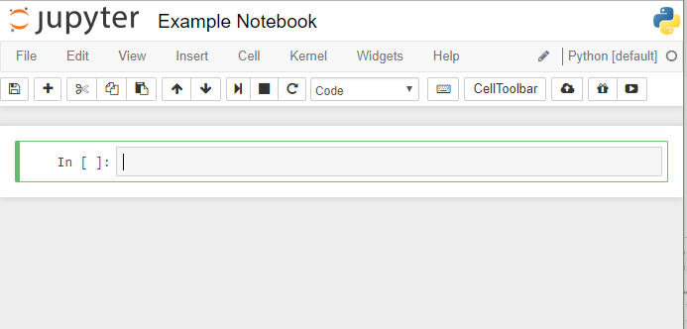
Cells
Cell type
+
Cells
Notes:
A Jupyter Notebook is a series of "Cells".
New cells can be created by clicking the "+" button in the top-left.
Each cell can contain either Code or Markdown.
The type of a cell can be controlled by the drop-down menu in the middle of the top toolbar.

Slide 8
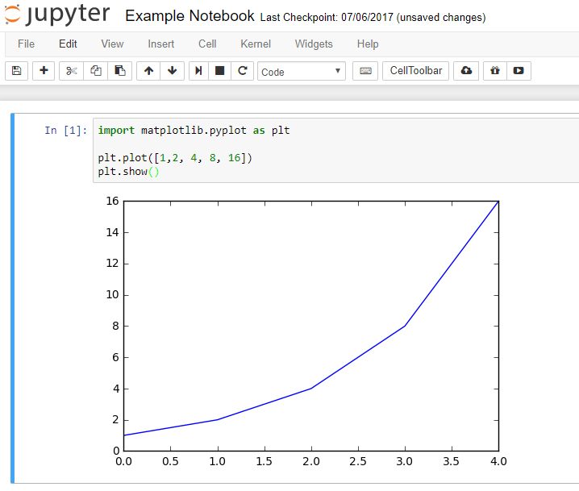
Code
Run button
Code
Output
Notes:
Code cells allow you to enter lines of Python code.
When you have finished editing the code, you can click the "Run" button in the toolbar.
The code will then be evaluated, and any output will be placed directly below the cell.

Slide 9
Markdown
Header
This text has italics.
This text is bolded.
# Header
This text has *italics*.
This text is **bolded**.
https://github.com/adam-p/markdown-here/wiki/Markdown-Cheatsheet
Notes:
Markdown is a way of writing text that will add formatting.
This formatting is similar to what you would find in a document editor like Word or Google Docs.
For instance, if you put asterixis around a word, it will be italicized.
If you put a hash symbol at the beginning of a line, it will become a section header.
For more information about writing Markdown, you can check out the documentation in the link provided.

Slide 10
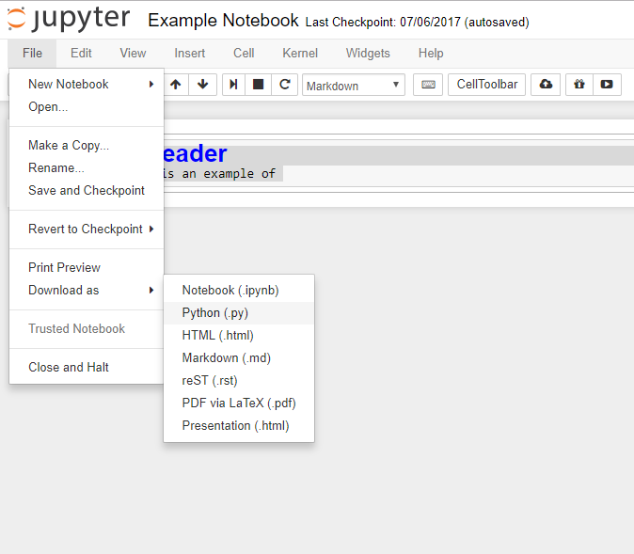
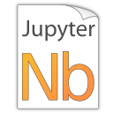
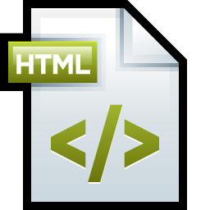
Downloading
Notebook (.ipynb)
HTML (.html)
Notes:
Once you have created your Notebook, you can share it with others by downloading it.
In the top right, click the "File" menu and hover over the "Download as" option.
Two useful ways of downloading the Notebook are as "Notebook (.ipynb)" and "HTML (.html)".
The Notebook file is the source file of the document, while the HTML file is shareable with non-programmers.

